Slide 1
Sunday December 29, 2024
1st Sunday of Christmas
Welcome!
Thank you for joining us
Placentia United Methodist Church

Slide 2
Christmas Candle Lighting

Slide 3
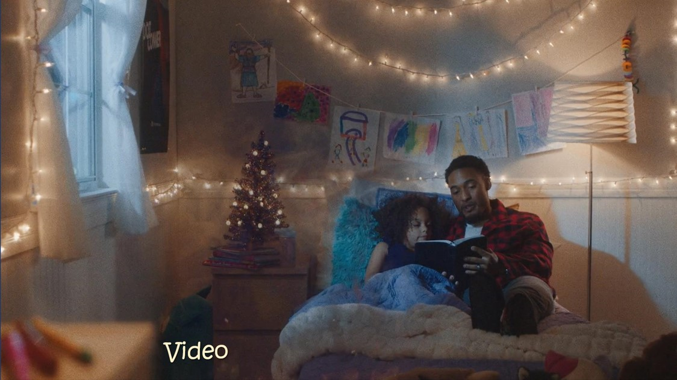

Slide 4
Gathering & Greeting

Slide 5
Angels We Have Heard on High
UMH #238 || CCLI License #1354319

Slide 9
Star-Child
Shirley Erena Murray ||TFWS # 2095 || CCLI License #1354319

Slide 11
Praying Together
All: Loving God, may we be found, and may we find a place called home, a place where faith holds us, and grace renews us. Where forgiveness longs for us to be who

Slide 12
Praying Together
you will us to be. May we find a place called home where we are accepted as we are, taken in and loved unconditionally. A place called home where we belong and

Slide 13
Praying Together
our souls fit. Where our questions are allowed, our anger is heard, our needs are recognized, our pain is held, and our names are known.

Slide 14
Praying Together
And may this be that place, O God, this group of travelers, doubters, and companions on the way. This home, your place, isn’t a building, but a way of being

Slide 15
Praying Together
in relationship; held together by love. Loving God, may we make this a home to all who still yet seek a place of grace-filled sanctuary and gracious welcome.

Slide 16
Praying Together
In Jesus’ precious name, Amen.

Slide 17
Prayers of the People

Slide 18
The Lord’s Prayer
UMH #895 ©1989

Slide 19
Our Father,
who art in heaven,
hallowed be thy name.

Slide 20
Thy Kingdom come,
thy will be done
on earth as it is in heaven.

Slide 21
Give us this day our daily bread.
And forgive us our trespasses,

Slide 22
as we forgive those who trespass
against us.

Slide 23
And lead us not into temptation,
but deliver us
from evil.

Slide 24
For thine is the
Kingdom, and
the power, and the glory, forever. Amen.

Slide 25
Let There Be Peace in Earth
One Holy Night in Bethlehem
Mary Nelson Keithahn | TFWS # 2097| CCLI License #1354319

Slide 26
One Holy Night in Bethlehem (verse 1)
1. One holy night in Bethlehem the air was filled with song. Angelic voices sang on high and shepherds piped along:

Slide 27
One Holy Night in Bethlehem (Refrain)
Sing glory, glory, gloria! God’s love is given birth! Be not afraid! Sing gloria, and peace to all the earth!

Slide 28
One Holy Night in Bethlehem (verse 2)
2. Their music echoed through the town into the stable stall, where Mary sang a lullaby and rocked her baby small:

Slide 29
One Holy Night in Bethlehem (Refrain)
Sing glory, glory, gloria! God’s love is given birth! Be not afraid! Sing gloria, and peace to all the earth!

Slide 30
One Holy Night in Bethlehem (verse 3)
3. As Joseph touched the lamb’s soft wool and fed the donkey hay, he whistled his own happy tune and thanked God for this day:

Slide 31
One Holy Night in Bethlehem (Refrain)
Sing glory, glory, gloria! God’s love is given birth! Be not afraid! Sing gloria, and peace to all the earth!

Slide 32
One Holy Night in Bethlehem (verse 4)
4. Be still, and you will hear tonight these melodies of old. Then join your voice in harmony until the tale is told:

Slide 33
One Holy Night in Bethlehem (Refrain)
Sing glory, glory, gloria! God’s love is given birth! Be not afraid! Sing gloria, and peace to all the earth!

Slide 34
Let There Be Peace in Earth

Slide 35
Scripture Reading
Psalm 148: 1-5, 13-14
Liturgist: Craig Green

Slide 36
Scripture Reading
Luke 2:41-52 (CEB)
Liturgist: Craig Green

Slide 37
All: Each year his parents went to Jerusalem for the Passover Festival. When he was 12 years old, they went up to Jerusalem according to their custom. After the festival was over, they

Slide 38
were returning home, but the boy Jesus stayed behind in Jerusalem. His parents didn’t know it. Supposing that he was among their band of travelers, they journeyed on for a full day while

Slide 39
looking for him among their family and friends. When they didn’t find Jesus, they returned to Jerusalem to look for him. After three days they found him in the temple.

Slide 40
He was sitting among the teachers, listening to them and putting questions to them. Everyone who heard him was amazed by his understanding and his answers.

Slide 41
When his parents saw him, they were shocked. His mother said, “Child, why have you treated us like this? Listen! Your father and I have been worried. We’ve been looking for you!”

Slide 42
Jesus replied, “Why were you looking for me? Didn’t you know that it was necessary for me to be in my Father’s house?” But they didn’t understand what he said to them.

Slide 43
Jesus went down to Nazareth with them and was obedient to them. His mother cherished every word in her heart.

Slide 44
Jesus matured in wisdom and years, and in favor with
God and with people.

Slide 45
Response: This is the Word of God for the people of God.
ALL: Thanks be to God.

Slide 47
O Little Town of Bethlehem
Phillips Brooks | UMH # 230 | CCLI License #1354319

Slide 48
O Little Town of Bethlehem (Verse 1)
1. O little town of Bethlehem, how still we see thee lie; above thy deep and dreamless sleep the silent stars go by.

Slide 49
Yet in thy dark streets shineth the everlasting light; the hopes and fears of all the years are met in thee tonight.

Slide 50
O Little Town of Bethlehem (Verse 2)
2. For Christ is born of Mary, and gathered all above, while mortals sleep, the angels keep their watch of wondering love.

Slide 51
O morning stars together, proclaim the holy birth, and praises sing to God the King, and peace to all on earth!

Slide 52
O Little Town of Bethlehem (Verse 3)
3. How silently, how silently, the wondrous gift is given; so God imparts to human hearts the blessings of his heaven.

Slide 53
No ear may hear his coming, but in this world of sin, where meek souls will receive him, still the dear Christ enters in.

Slide 54
O Little Town of Bethlehem (Verse 4)
4. O holy Child of Bethlehem, descend to us, we pray; cast out our sin, and enter in, be born in us today.

Slide 55
We hear the Christmas angels the great glad tidings tell; O come to us, abide with us, our Lord Emmanuel!

Slide 57
Offering & Doxology

Slide 58
Doxology Hymn
UMH #94 ©1989 The United Methodist Publishing House

Slide 59
Praise God, from whom
all blessings flow;

Slide 60
Praise God all creatures
here below:

Slide 61
Alleluia! Alleluia! Praise God, the source of all our gifts!

Slide 62
Praise Jesus Christ, whose power uplifts!

Slide 63
Praise the Spirit, Holy Spirit! Alleluia! Alleluia! Alleluia!

Slide 65
Go, Tell It On the Mountain
John W. Works || UMH #251 || CCLI License #1354319

Slide 66
Go, Tell It on the Mountain (Refrain)
Go, tell it on the mountain, over the hills and everywhere; go, tell it on the mountain, that Jesus Christ is born.

Slide 67
Go, Tell It on the Mountain (Verse 1)
1. While shepherds kept their watching o’er silent flocks by night,

Slide 68
Go, Tell It on the Mountain (Verse 1)
behold throughout the heavens there shown a holy light.

Slide 69
Go, Tell It on the Mountain (Refrain)
Go, tell it on the mountain, over the hills and everywhere; go, tell it on the mountain, that Jesus Christ is born.

Slide 70
Go, Tell It on the Mountain (Verse 2)
2. The shepherds feared and trembled, when lo! above the earth, rang out the angel chorus that hailed the Savior’s birth.

Slide 71
Go, Tell It on the Mountain (Refrain)
Go, tell it on the mountain, over the hills and everywhere; go, tell it on the mountain, that Jesus Christ is born.

Slide 72
Once in Royal David’s City (Verse 3)
3. Down in a lowly manger the humble Christ was born, and God sent us salvation that blessed Christmas morn.

Slide 73
Go, Tell It on the Mountain (Refrain)
Go, tell it on the mountain, over the hills and everywhere; go, tell it on the mountain, that Jesus Christ is born.

Slide 75
Sending Blessing

Slide 76
Jesus welcomes children and so do we! Families and households are invited for worship. We have a children’s table in the sanctuary and volunteers ready to teach a small group.

Slide 77
Thank you for your faithful
& generous support

Slide 78
This concludes our livestream.
Thank you for worshipping
with us. We wish you a safe &
Spirit-filled week ahead.

